Slide 1

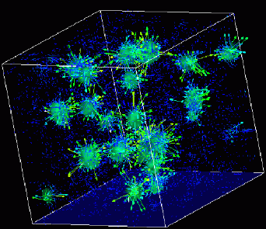

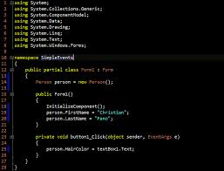
Advanced
Scientific Computing
(SciComp 201)
Session 28
Searching and Binning

Slide 2
Bin Counting
Given a very large ordered sequence, how can we count the number of items that fall between a given range?
This capability forms the basis of most routines used to create histograms
It is an easy problem if the item domain $∈ ℤ$ – but what if the item domain is not easily countable? (i.e. domain $∈ ℝ)$
This is a “big data” challenge – an efficient approach provides a pattern which can be employed to solve a diverse set of problems

Slide 3
Bin Counting
Given a range
0.3266 ≤ x ≤ 0.8179
Find the lowest and highest index numbers for all items within the given range
Example:
lowIndex = 3
highIndex = 9
Number of items = 9 – 3 = 6

Slide 4
Bin Counting
Create a vector<double> holding 3,000,000 items
Each item have random value between 0.0 and 1.0 (uniform PDF)
The array is sorted from lowest to highest item value
Create 10 random ranges, where for each range:
0.0 ≤ rangeLow < 0.5
0.5 ≤ rangeHigh < 1.0
Determine how many CPU clock cycles it takes to sum the number of items that fall within each of the 10 ranges
You don’t know a priori the low/high values of each range

Slide 5
Lab 1 – Implement FindRangeSlow()
Write code to sequentially scan through the global sorted items vector
Set the outbound indexLow variable to be the index of the first item with a value >= rangeLow
Set the outbound indexHigh variable to be the index of the last item with a value <= rangeHigh
The function should return false if there are no items in entire the list with a value <= rangeLow
Otherwise the function should return true

Slide 6
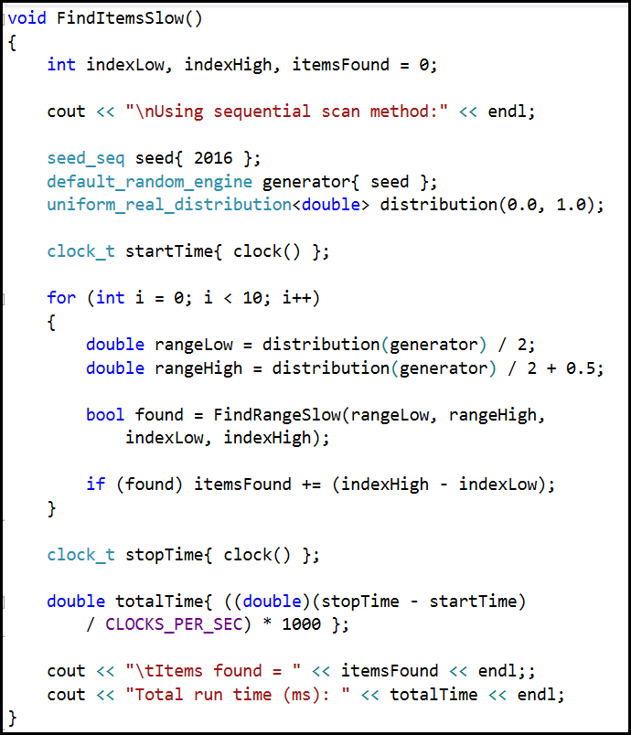
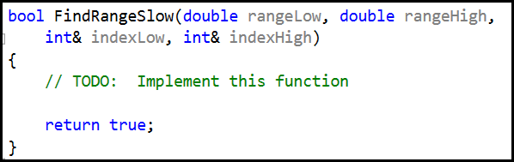
Lab 1 FindRangeSlow()

Slide 7
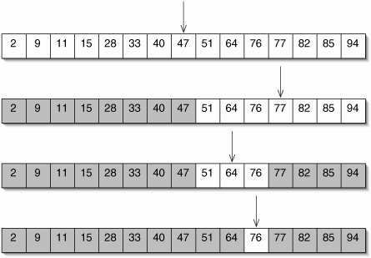
Bin Counting
The FindItemsFast() function uses a binary search to locate the low and high end of each range

Slide 8
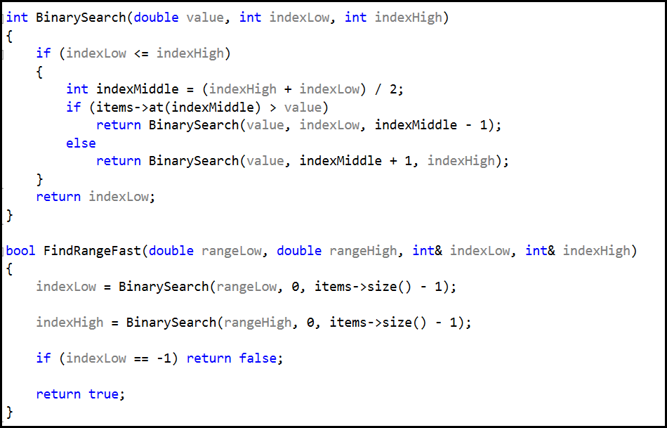
Lab 2 – Bin Counting

Slide 9
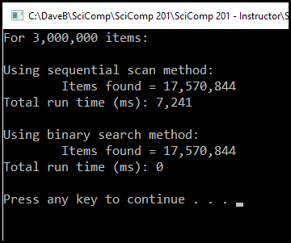
Lab 2 – Bin Counting

Slide 10
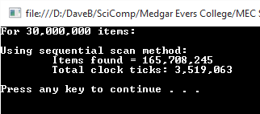
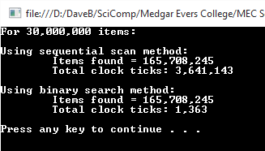
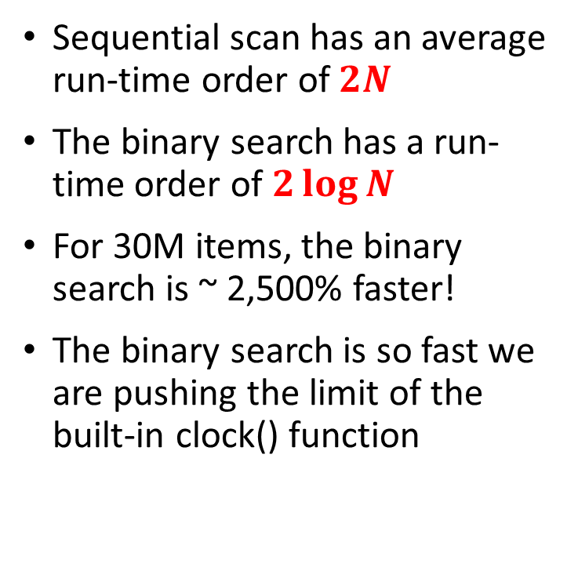
Bin Counting
Sequential scan has an average run-time order of $2N$
The binary search has a run-time order of $2\log{N}$
For 30M items, the binary search is ~ 2,500% faster!
The binary search is so fast we are pushing the limit of the built-in clock() function

Slide 11
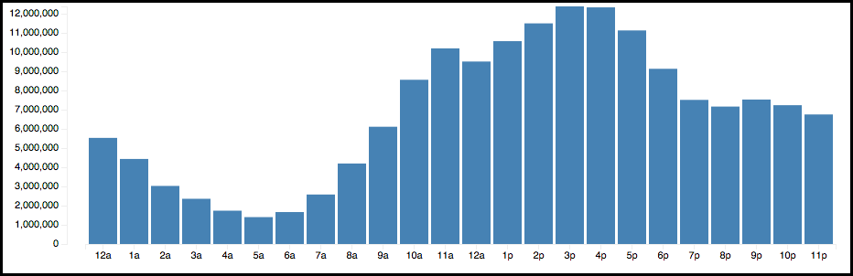
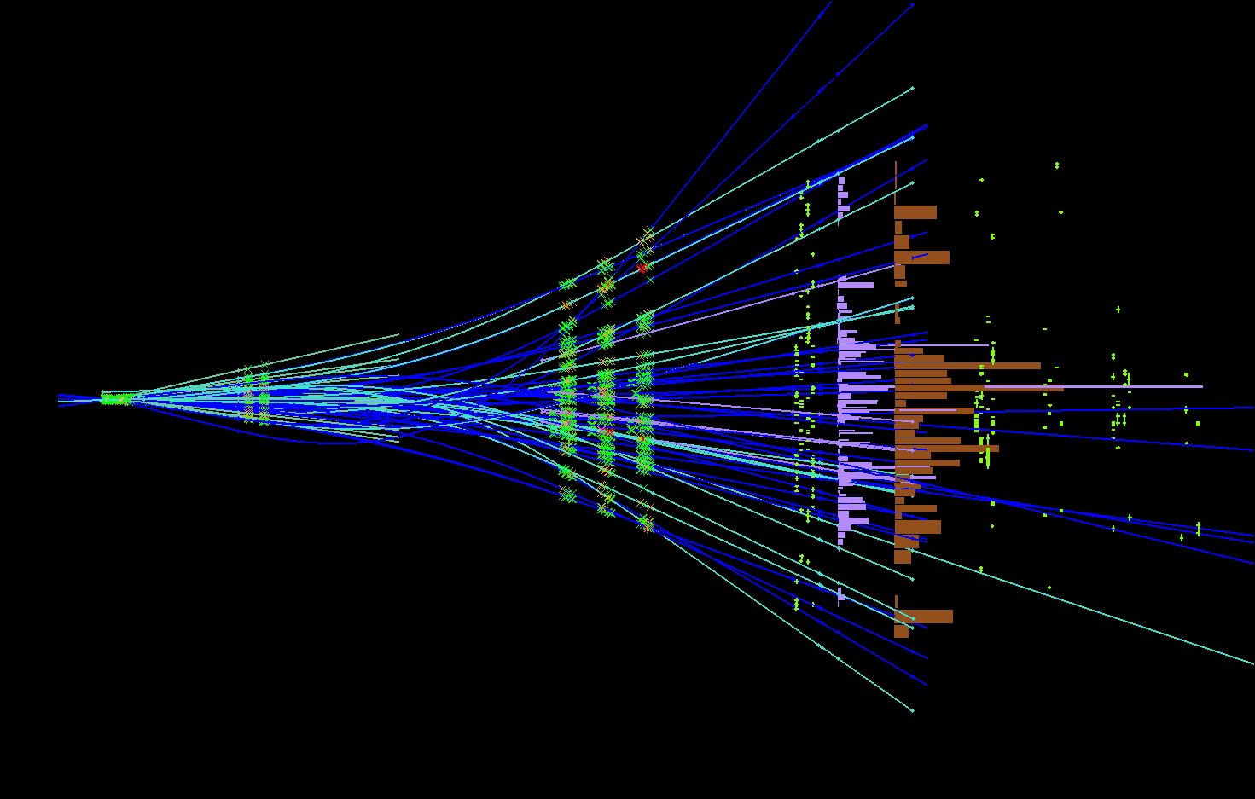

Bin Counting

Slide 12
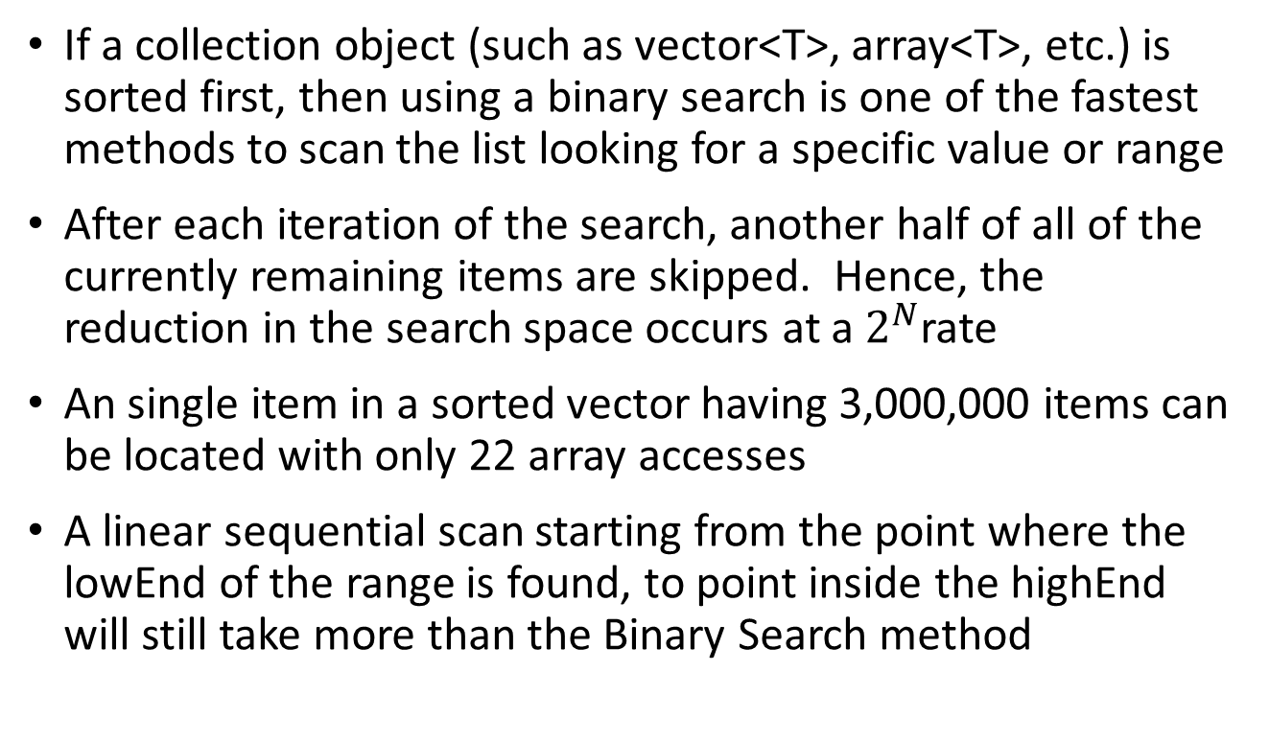
Now you know…
If a collection object (such as vector<T>, array<T>, etc.) is sorted first, then using a binary search is one of the fastest methods to scan the list looking for a specific value or range
After each iteration of the search, another half of all of the currently remaining items are skipped. Hence, the reduction in the search space occurs at a $2^{N}$rate
An single item in a sorted vector having 3,000,000 items can be located with only 22 array accesses
A linear sequential scan starting from the point where the lowEnd of the range is found, to point inside the highEnd will still take more than the Binary Search method

